Slide 1
Retroactive interference in recognition memory The roles of mental effort and consolidation
Caleb J. Picker
Psychology Department
University of Nevada, Las Vegas

Slide 2
Outline
Recollection and familiarity
Mental effort and consolidation
Experiment & Predicted results

Slide 3
Outline
Recollection and familiarity
Mental effort and consolidation
Experiment & Predicted results

Slide 4
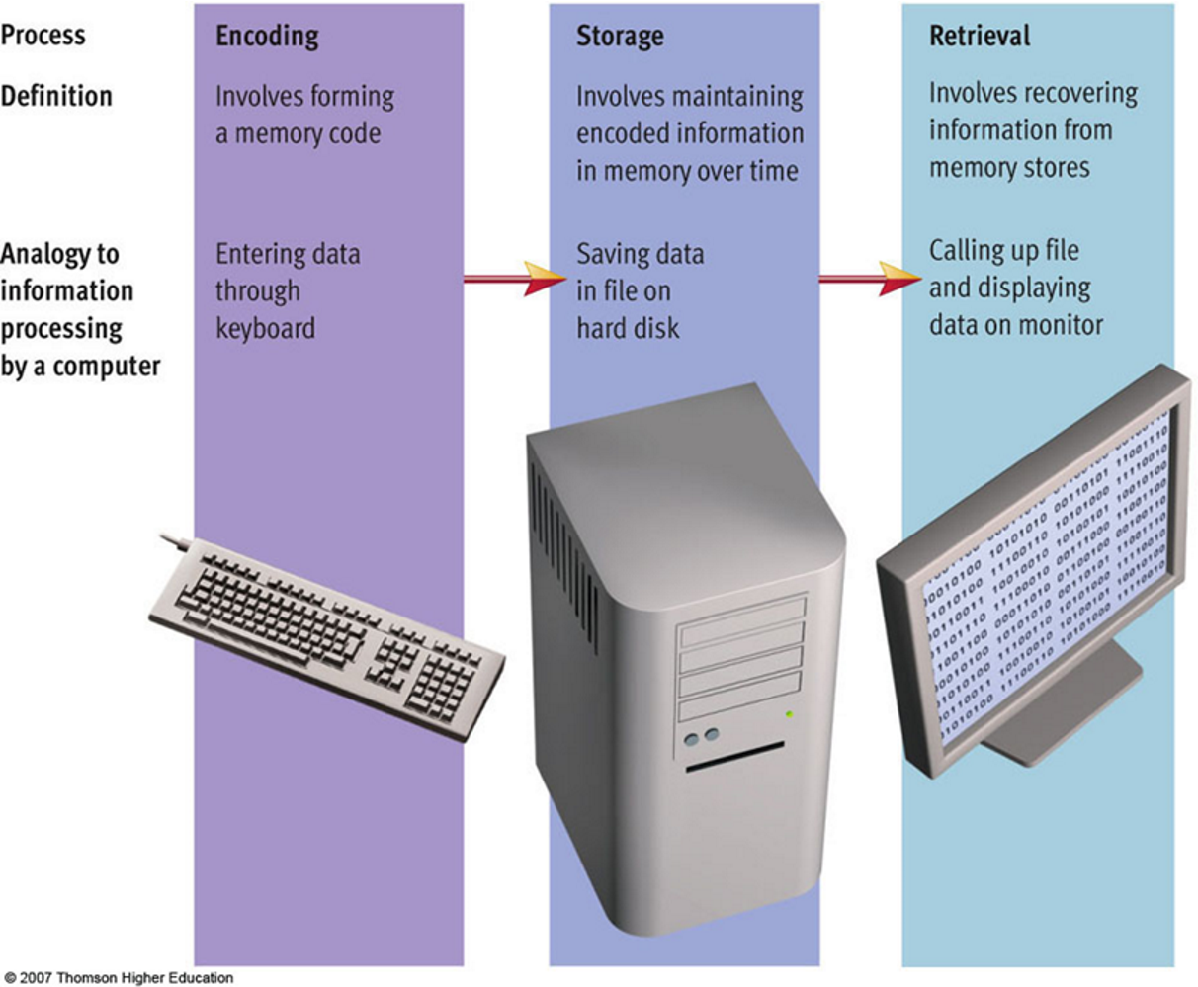
Definition of memory
Memory is the ability to encode, store, and retrieve different types of information
Weiten (2008)

Slide 5
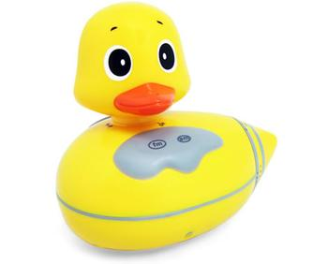
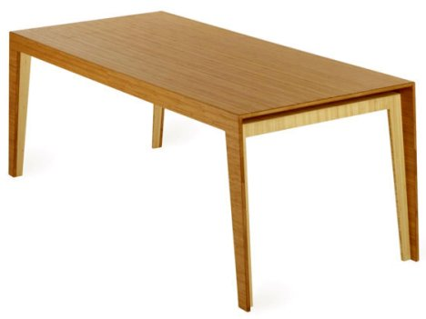
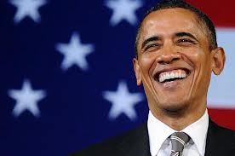
Recognition memory processes
Helps you recognize the difference between old and new events, and recognition depends on recollection of past details and familiarity for old and new events
Random things
Where you left your coffee mug
Recognize the president

Slide 6
Types of information in memory
Even remembering that a duck was presented at the same time as Obama

Slide 7
Did you see this before?

Slide 8
Did you see this before?

Slide 9

Did you see this before?

Slide 10
Did you see these paired together?

Slide 11
Familiarity and recollection
You probably felt that older items were more familiar than newer items (familiarity)
You probably recollected the ‘rubber duck’s’ bounce entrance (recollection)
Even though you saw the ‘duck’ and ‘mouse’ before, you had to use recollection to answer whether they were associated before

Slide 12
Forgetting
If I tested you a year from now, what would cause you to forget the rubber duck, President Obama, and other information contained in this lecture?

Slide 13
Outline
Recollection and familiarity
Mental effort and consolidation
Experiment & Predicted results

Slide 14
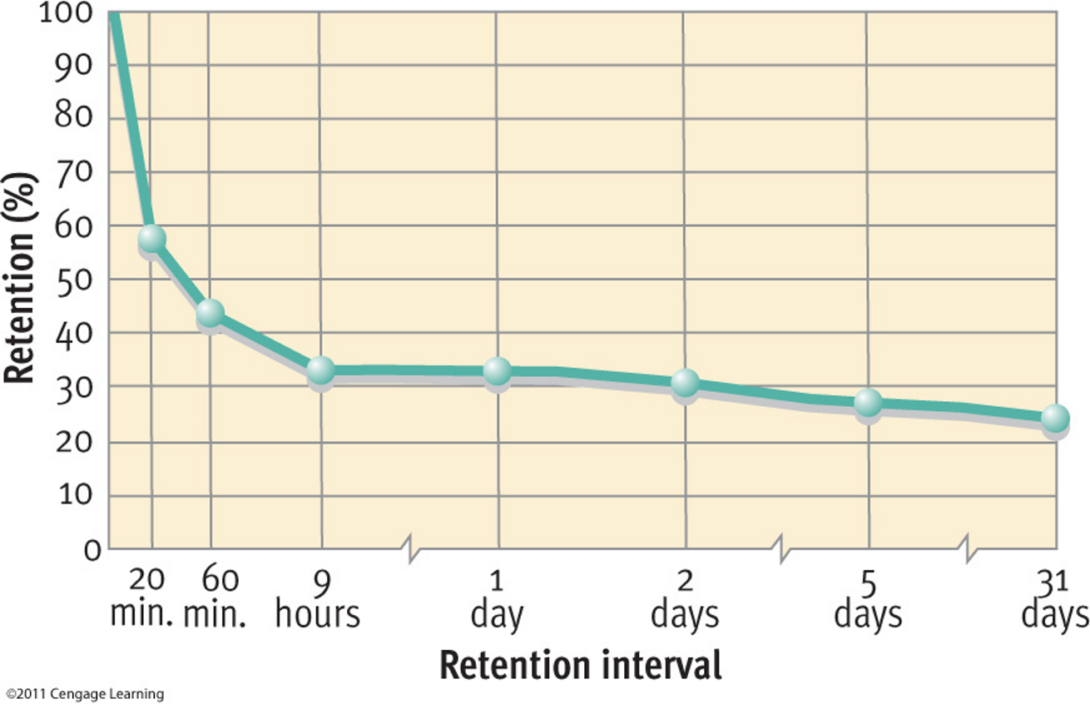
Forgetting curve
Forgetting is the loss of once-retrievable information (Wixted, 2010)
Weiten (2008)

Slide 15
Consolidation and retroactive interference
Rate of forgetting slows down over time, suggesting information in memory is somehow strengthened (consolidation)
Previously learned information is forgotten because of learning new information (retroactive interference)
Retroactive interference (RI) is greatest when there has been less time for consolidation

Slide 16
Retroactive interference example experiment

Slide 17
Retroactive interference example experiment

Slide 18
Retroactive interference example experiment
Is this intact or rearranged?

Slide 19
Mental effort and similarity
Adapted from Dewar, Cowan, & Della Sala (2007)

Slide 20
Mental effort and similarity
Adapted from Dewar, Cowan, & Della Sala (2007)

Slide 21
Mental effort and similarity
Adapted from Dewar, Cowan, & Della Sala (2007)

Slide 22
Skaggs-Robinson hypothesis
Reproduced from Skaggs (1925)
Notes:
Come back ere and make grapic better!

Slide 23
Mental effort and recollection
Mental effort may affect consolidation processes (Wixted, 2004; 2005; 2010) crucial for recollection
- Sleep enhances recollection-dependent source recognition memory but not familiarity-dependent item recognition memory (van der elm … , 2011)
- Blocking new learning with a drug enhances memory for old information (Reder et al., 2007)
Notes:
Similarity affects recollection discrimination and biases all items to feel familiar (Verde, 2004)

Slide 24
Outline
Recollection and familiarity
Mental effort and consolidation
Experiment & Predicted results

Slide 25
Experiment
Research questions
Does mental effort cause forgetting?
Does decreasing the amount of time for consolidation cause more forgetting?

Slide 26
Experiment Design
Create graphic

Slide 27
Experiment Design
Create graphic

Slide 28
Experiment Design
Create graphic

Slide 29
Experiment: Main effect of mental effort
Main effect of mental effort: If mental effort selectively affects recollection (but not familiarity), then more mental effort results in smaller recollection estimates.

Slide 30
Experiment: Main effect of time for consolidation
Main effect of time for consolidation: If interference is greater when presented immediately after study than later, then recollection estimates should be smaller in the 0 minute condition than in other conditions.

Slide 31
Experiment: Interaction
Interaction between mental effort and time for consolidation: More mental effort and less time for consolidation results in smallest recollection estimates.

Slide 32
Experiment: Tentative discussion
If obtained, these data would suggest that mental effort disrupts consolidation of memories, which can affect the ability to recollect past information

Slide 33
Other research
Other research questions
How does similarity affect recollection and familiarity?

Slide 34
Experiment 2: Design

Slide 35
Experiment 2: Hypotheses for recollection
Associative recognition with interference lures
If participants are required to discriminate between studied and interference information at test, then participants will have particular difficulty with highly similar lures, but probably not for repetitions. As similarity decreases, recollection at first decreases dramatically and then increases.
Pair recognition
If participants are not required to discriminate between studied and interference information at test, then participants may see a benefit in recognition memory performance if the similar interference information is mistaken for studied information. As similarity decreases, recollection estimates should gradually decrease (and be relatively preserved in control).

Slide 36
Experiment 2: Predicted results for recollection

Slide 37
Experiment 2: Hypotheses for familiarity
Associative recognition with interference lures
If participants are required to discriminate between studied and interference information at test, then participants may not see a benefit in recognition memory performance if the similar interference information is mistaken for studied information. This should lead all items to feel equally familiar (leading to larger familiarity estimates at greater degrees of similarity).
Pair recognition
The effect should be the same as above, except familiarity estimates should be larger overall (because there familiarity can contribute more to performance).

Slide 38
Experiment 2: Predicted results for familiarity

Slide 39
Experiment 2: Tentative discussion
Repetition
If obtained, these results would suggest that recollection benefits from repetition, like familiarity.
Interference lures versus pair recognition
However, when discrimination between studied and interference lures is required, a high degree of interference similarity hurts recollection more than when such discrimination is not required.
The opposite is true for familiarity: having more similar items in memory simply biases participants to think all items are similar.

Slide 40
Theoretical and broader implications of predicted results
Theoretical implications
Mental effort is a source of variance in everyday forgetting (that seems to selectively affect recollection!)
Broader implications
Allowing students, patients with amnesia, children, and older adults time to consolidate information without engaging in subsequently mentally effortful material should enhance their ability to recollect information
Other research
Investigate the role of similarity in recognition memory
Notes:
Other research
Similarity is another source of forgetting that reduces recollection-based discrimination in a different way than mental effort does
When people are unaware of differences between similar stimuli, their recollection-based discrimination is unaffected
As people learn about more similar things, everything starts to seem familiar!
In addition, making the learning of new information less similar to old information should decrease chances of errors

Slide 41
Acknowledgments
Advisor
Colleen M. Parks
Graduate student peers
Wei An
And others
Friends and family
My audience (you!)

Slide 42
Thank you!

